Slide 1
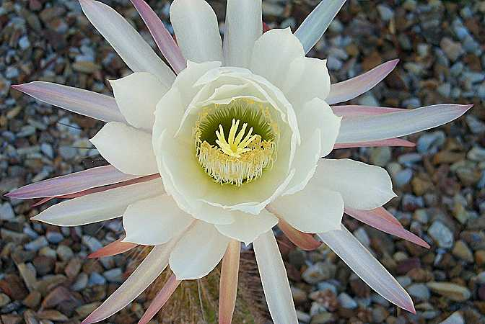
Reproductive Parts of a Flowering Plant

Slide 2
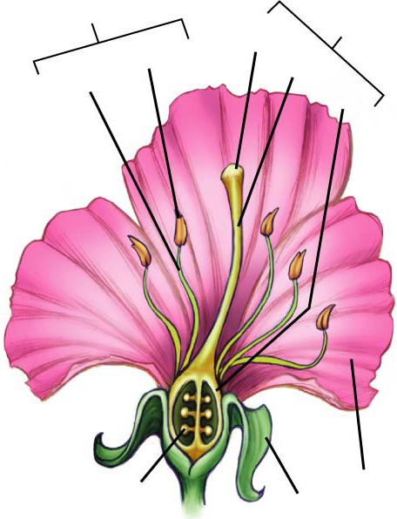
Flowers contain the reproductive organs of angiosperms.
Flowers come in many shapes, colors, and fragrances that attract pollinators or catch the wind.
Stamen
Pistil
Anther
Stigma
Filament
Style
Ovary
Petal
Ovule
Sepal

Slide 3
Flowers usually contain the following parts: sepals, petals, stamen, and pistils.
Sepal – encloses & protects the flower before it blooms (it covers the flower bud)
Petals – broad, flat, and thin – they vary in shapes and colors. They attract insects or other animals to the flower.

Slide 4
3. Stamen – male reproductive structure
3a. anther – sac-like structure that produces pollen (contains sperm cell)
3b. Filament – thin stalk that holds the anther

Slide 5
4. Pistil – female reproductive structure
4a. Stigma – the tip of the pistil; often sticky or feathery; it captures the pollen
4b. Style – long slender part of the pistil
4c. Ovary – rounded base of the pistil that contain the ovules
4d. Ovule – contains an egg cell

Slide 6
Pollination and Fertilization
Pollination – transfer of pollen from stamen to pistil
1. Anther produces pollen – Pollen contain sperm cells
2. Pollen gets transferred to the stigma by insects, birds, bats, wind…
3. A pollen tube forms in the style
4. Sperm cells from the pollen travel down to the ovules in the ovary

Slide 7
5. Sperm cells (in the pollen) fertilize the eggs (in the ovules)
Fertilization – when the sperm cell unites with the egg cell (a zygote is formed)
From Flower to Fruit
6. Petals and stamen fall away
7. The ovary develops into the fruit and the ovules develop into the seeds
8. The seeds disperse and grow into new plants

